Slide 1

introduce
Tadpole for DB Tools
Cho hyun jong(V0.1, 12/09/10) http://goo.gl/Q6Vax http://hangumkj.blogspot.com/ hangum@gmail.com

Slide 2
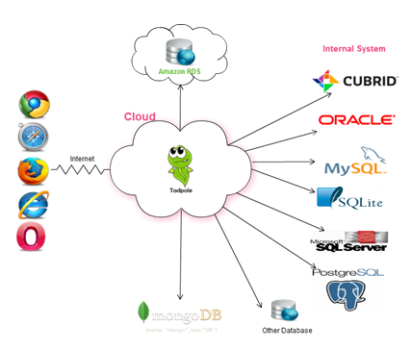
Tadpole for DB Tools
DB Management
SQL Tools
ERD View
User Management
SQL Authorize
SQL Profile
Report

Slide 3







Person
Only one tools
Favorite query save

Slide 4
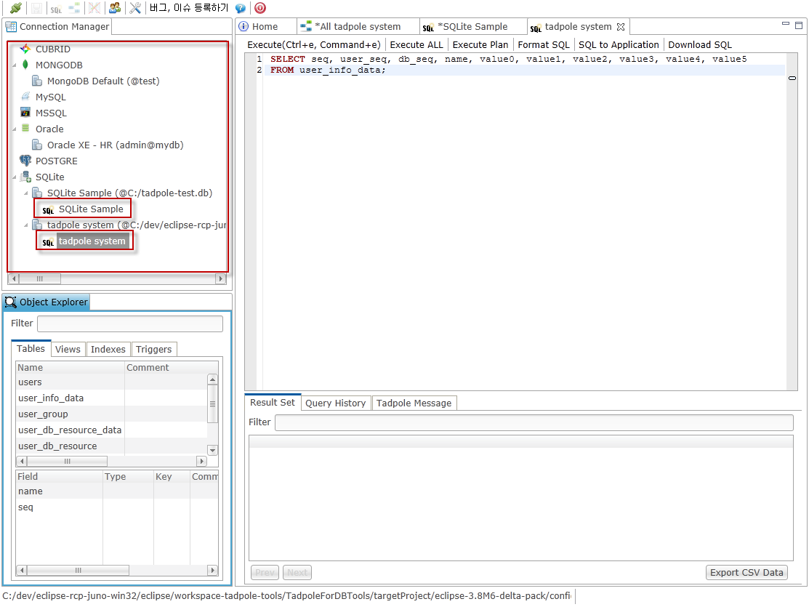
Tadpole - Person User
Support DB
Oracle
MySQL
PostgreSQL
CUBRID
MSSQL
SQLite
MongoDB
Favorite query save

Slide 5

TEAM
Authorize
Team leader : table schema creation
Team member : DML only
query sharing between team member
DML and Object Source Configuration Management
Notes:
권한
팀원들간의 주요 쿼리 공유
Query 및 Object Source 형상관리

Slide 6
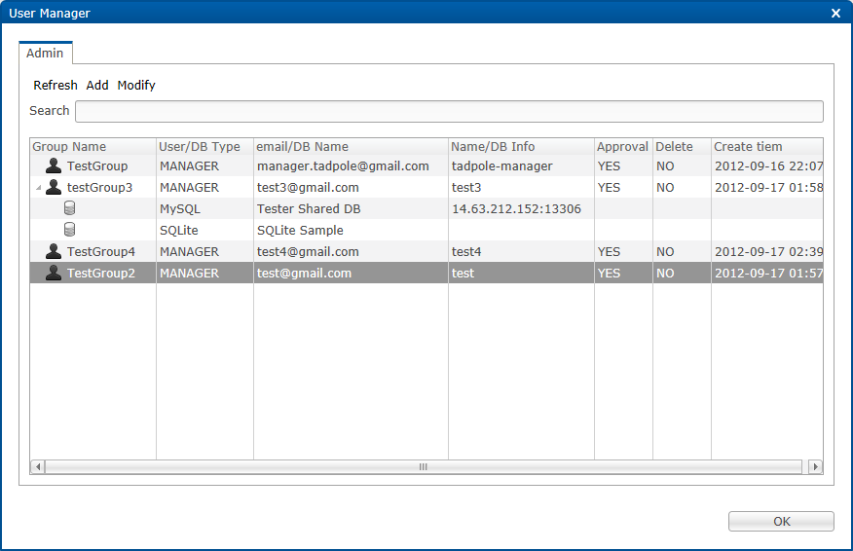
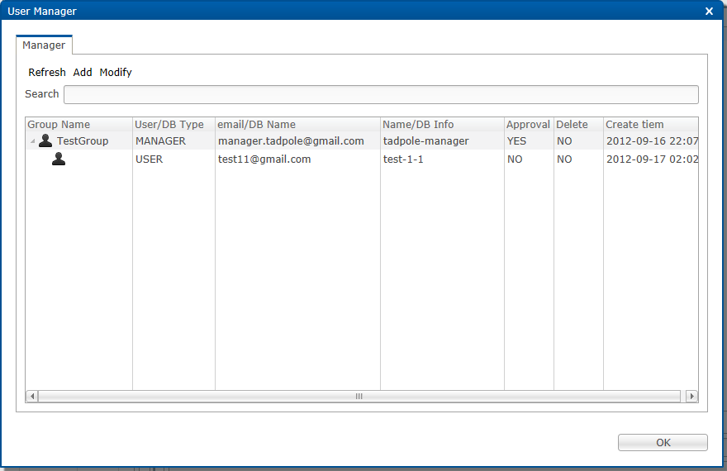
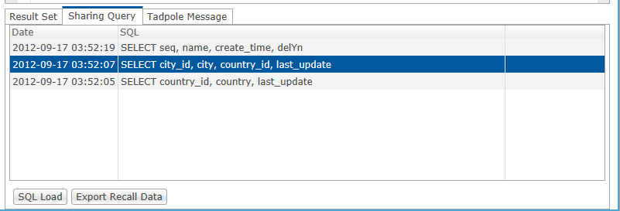
Tadpole – Team User
User Authorize
DB Authorize
Sharing Query

Slide 7
Company
A Team
B Team
DBA
Schema management
Team Control
User Control
DBA Query
Query sharing DBA and Team member
Report execute query
Data Security
Specific table DML ,DDL impossible
C Team
D Team
DBA Team

Slide 8
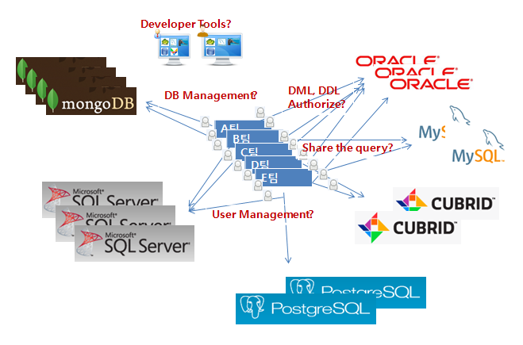
Company’s situation

Slide 9
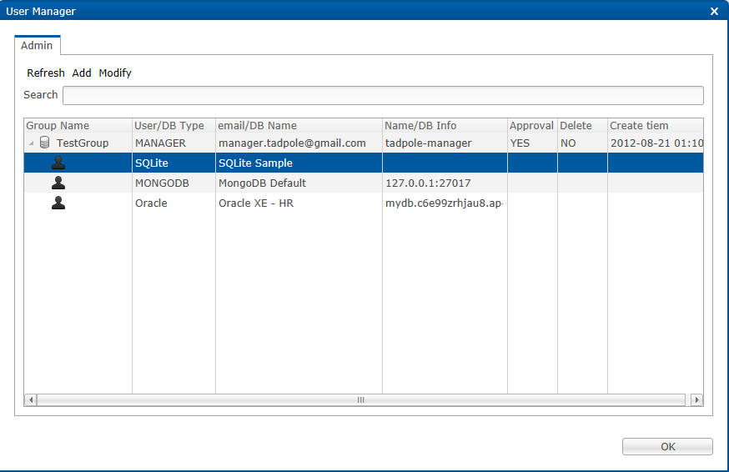
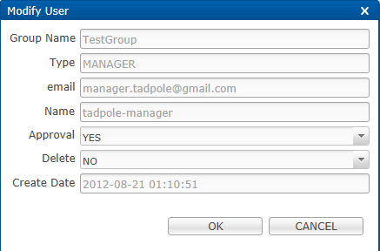
User Management
User Management
DB user management
User table permission

Slide 10
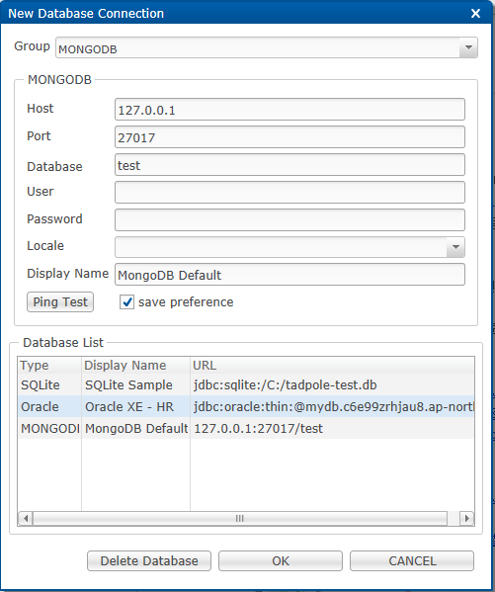
DB Management
Add, Delete Database

Slide 11
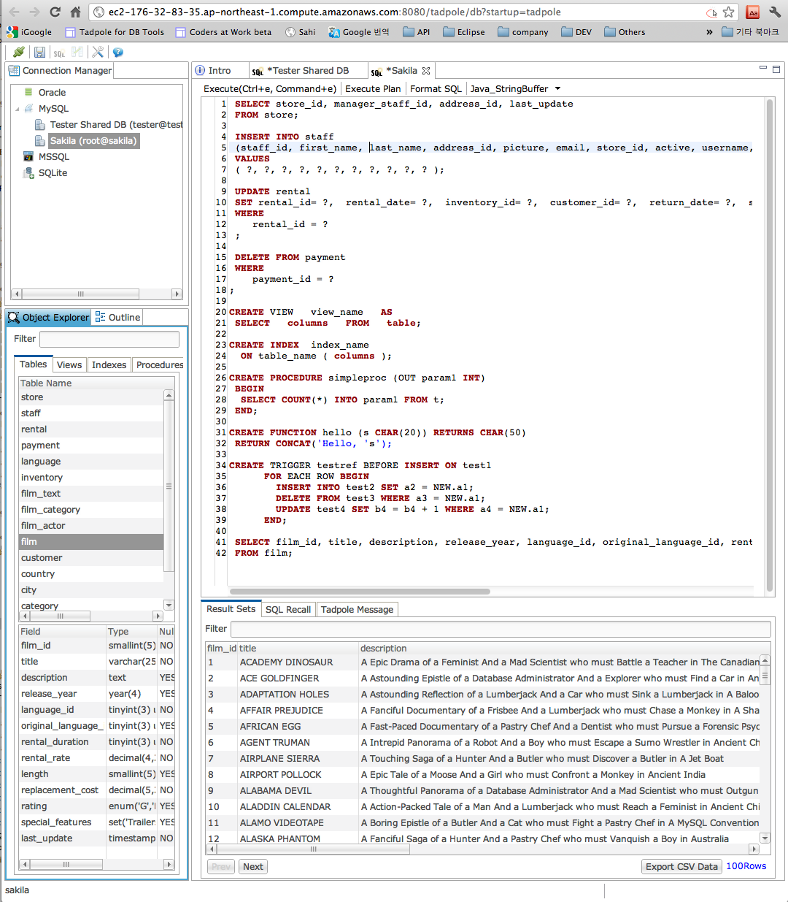
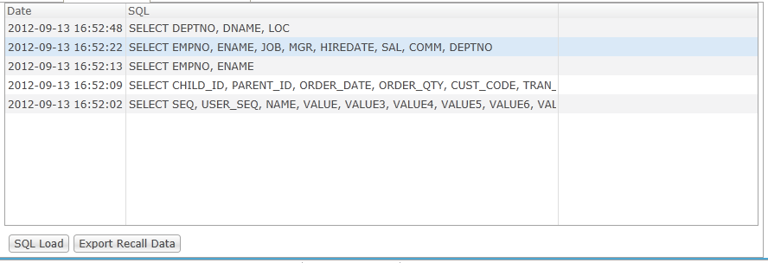
RDB
DML, DDL Template
Execute query
Export query data
Direct edit table
Authority Table, View, Procedure
Save user query
Share user query
Generate Sample data

Slide 12
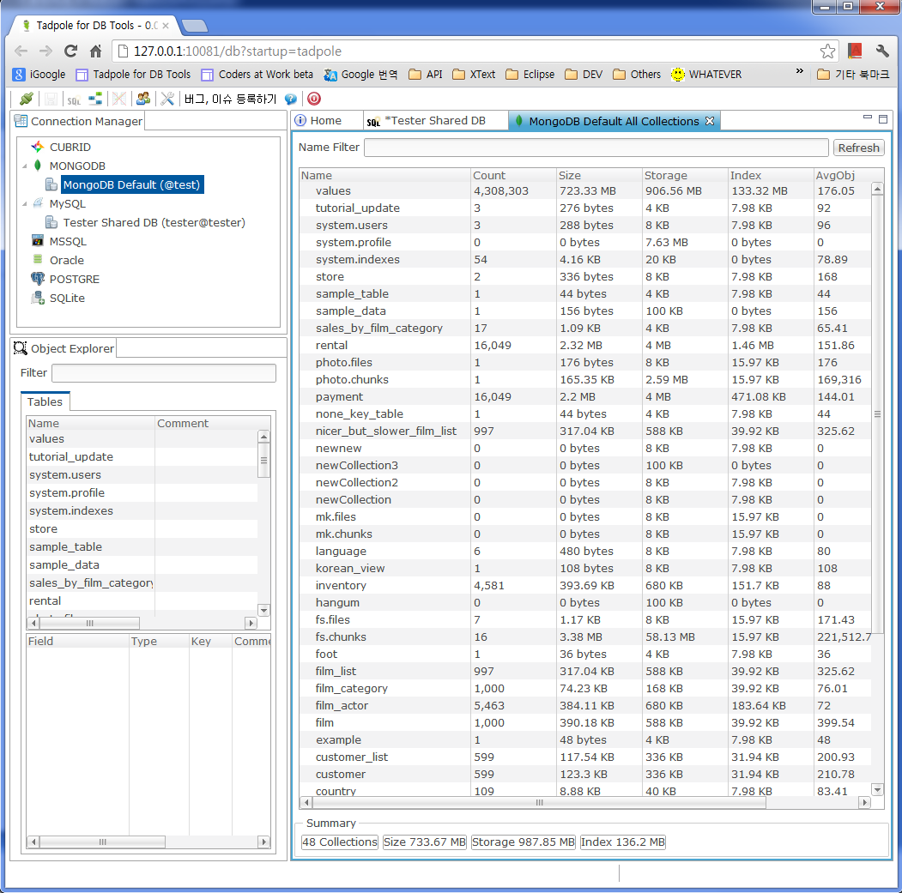
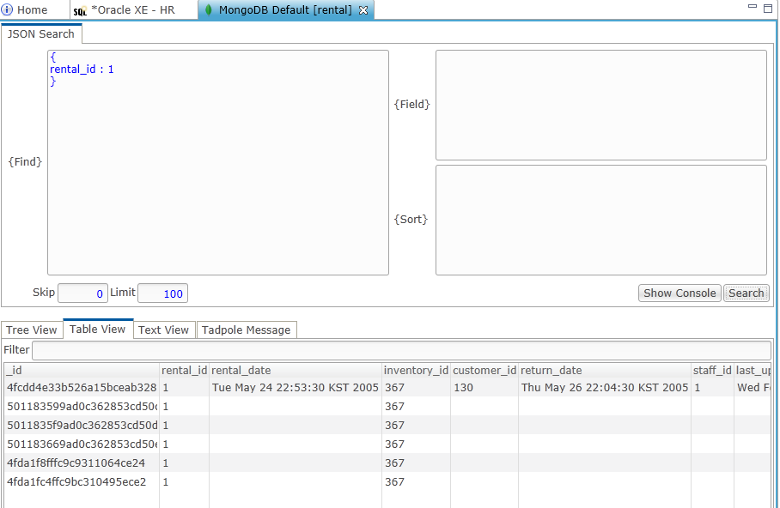
MongoDB
Show Collection Summary
Show Collection, Field
Query
Top
Support GridFS
Support Profile
Collection Diagram

Slide 13
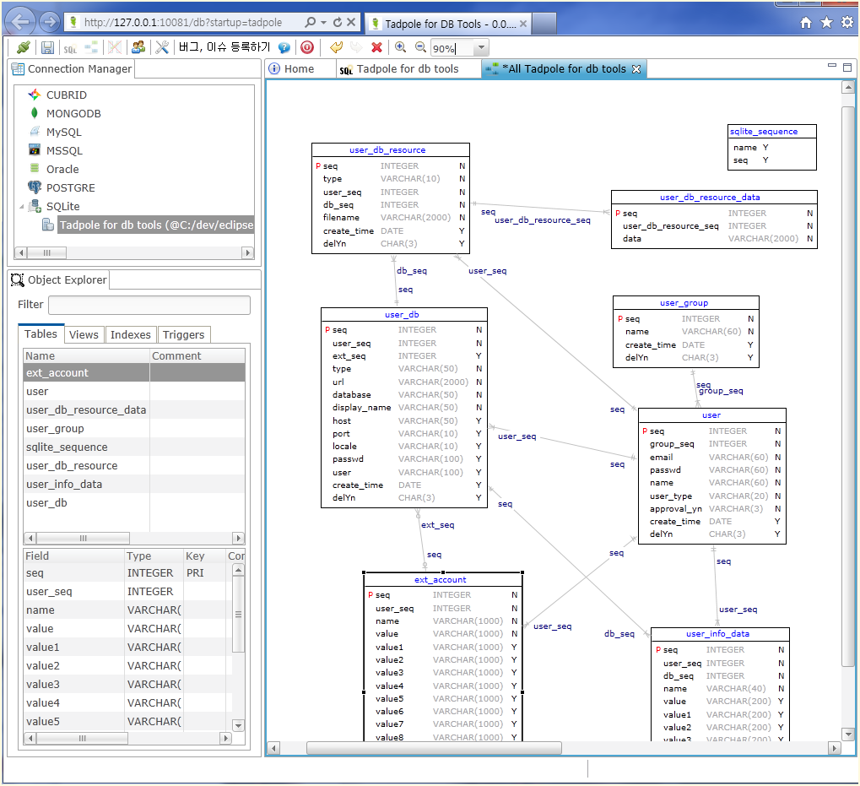
ERD View
All Table View
Auto Layout

